Slide 1

Forest-based economy: An alternative to promote resilience in the northern Bolivian Amazon
Photo: P. Laguna/Conservación Amazónica- ACEAA

Slide 2
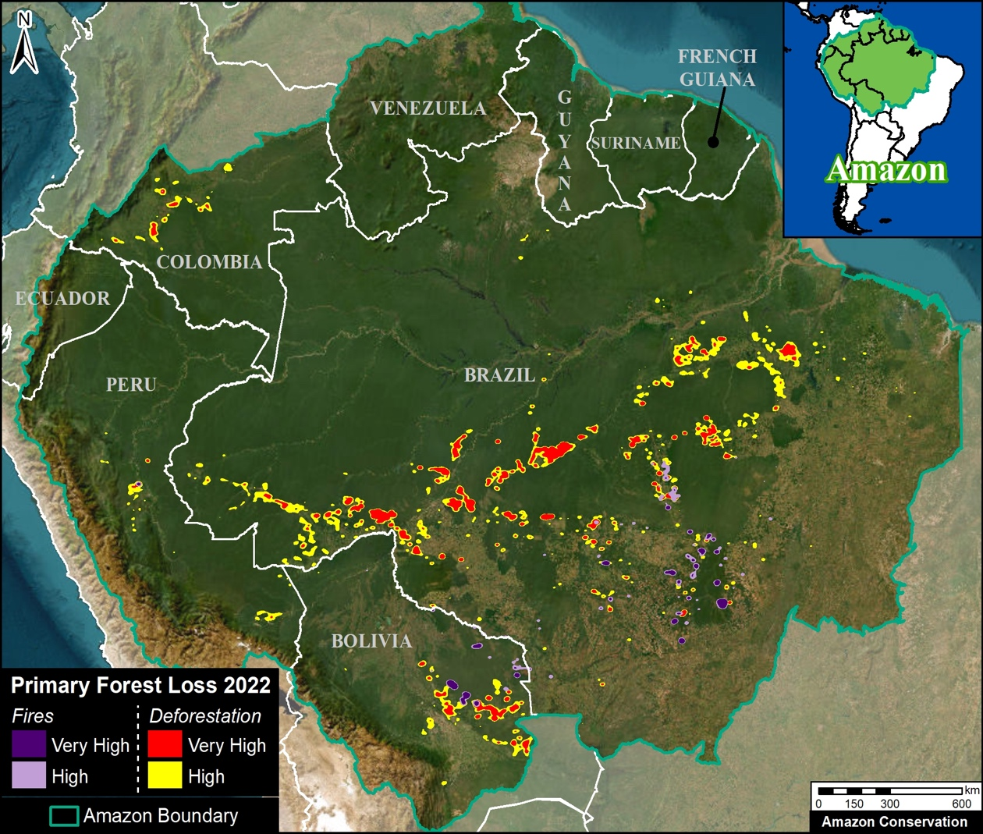
We are facing a critical scenario in the whole amazon región.
Forest loss is more than 2 million hectares per year.
The main deforestation drivers are:
  Agricultural frontier expansión
  Fires
  Mining
Source: MAAP/Amazon Conservation
Notes:
MAAP Questions:
Where does MAAP end and our work with partners and governments begin? What should be underneath MAAP?
2

Slide 3
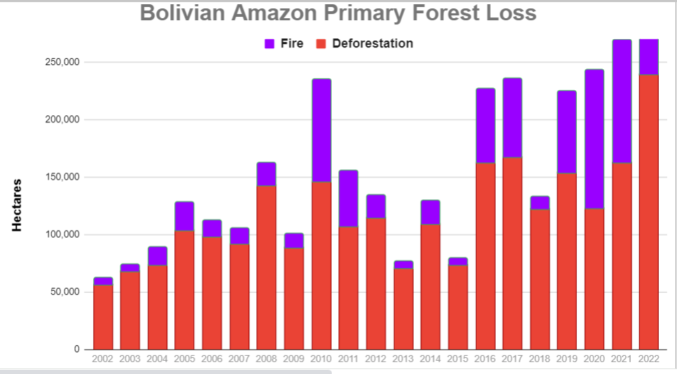
Bolivian Amazon Primary Forest Loss
Source: MAAP/Amazon Conservation
Notes:
MAAP Questions:
Where does MAAP end and our work with partners and governments begin? What should be underneath MAAP?
3

Slide 4
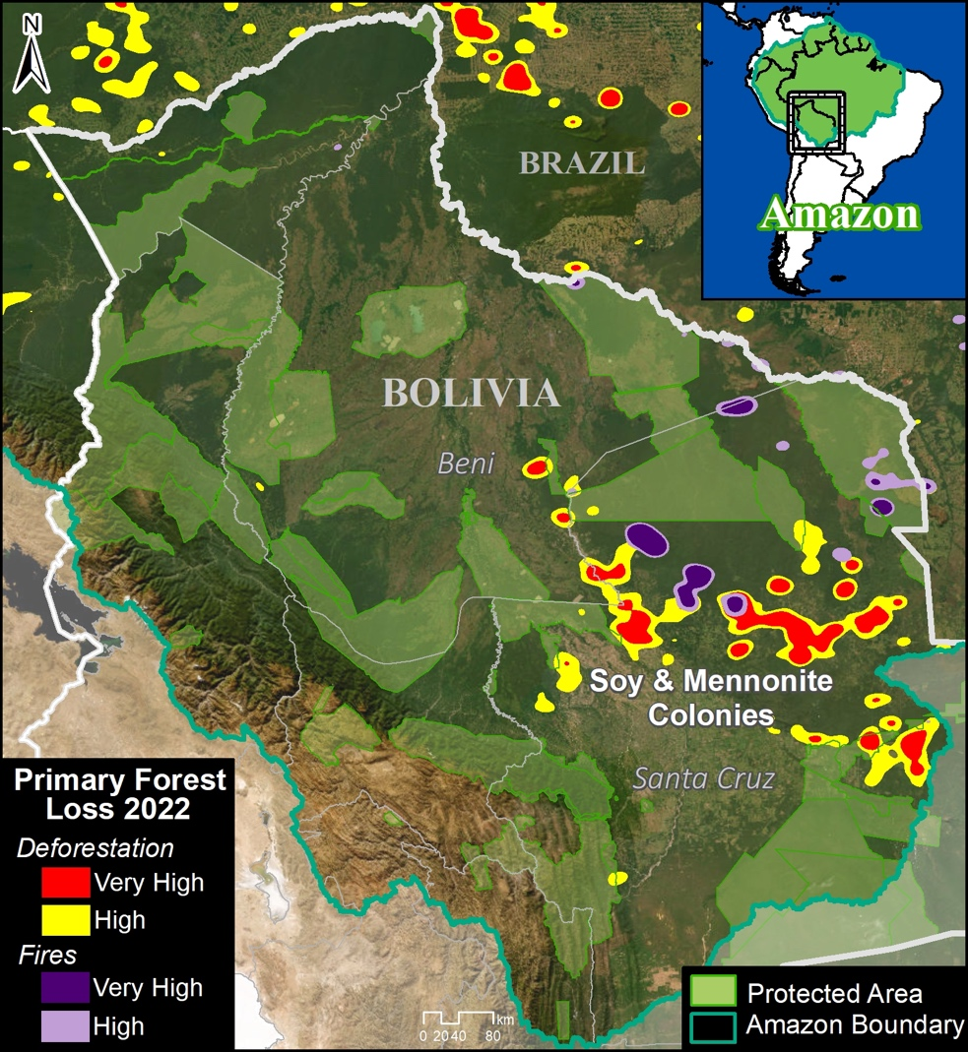
Forest loss in Bolivia is located mainly in Santa Cruz department, due agribusiness expansión.
Beni and La Paz departments are the next locations for agribusiness expansion
Pando is in the same risk, but has more pressure by Brasil´s deforestation trends
Source: MAAP/Amazon Conservation
Notes:
MAAP Questions:
Where does MAAP end and our work with partners and governments begin? What should be underneath MAAP?
4

Slide 5
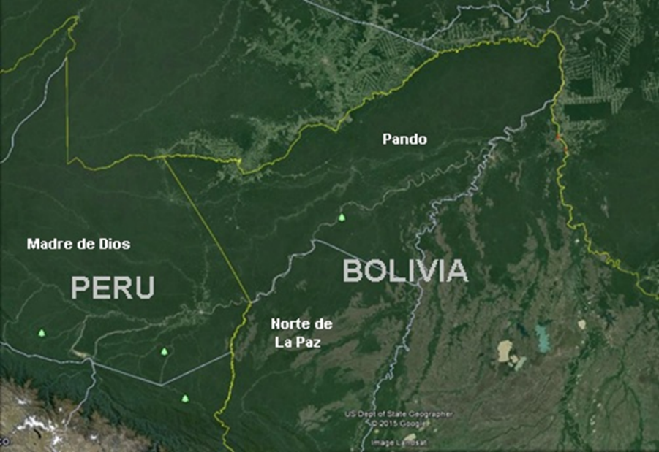
PANDO has more tan 300 agroextractive communities.
PANDO just hold 3% of annual national deforestation (aprox. 8000 ha per year).
PANDO since 2010 to 2020, just recorded a 4% of its Surface with fires.
PANDO has 92% (5,8 million ha) of its surface covered by forests
... but, why?
Source: Google Earth

Slide 6
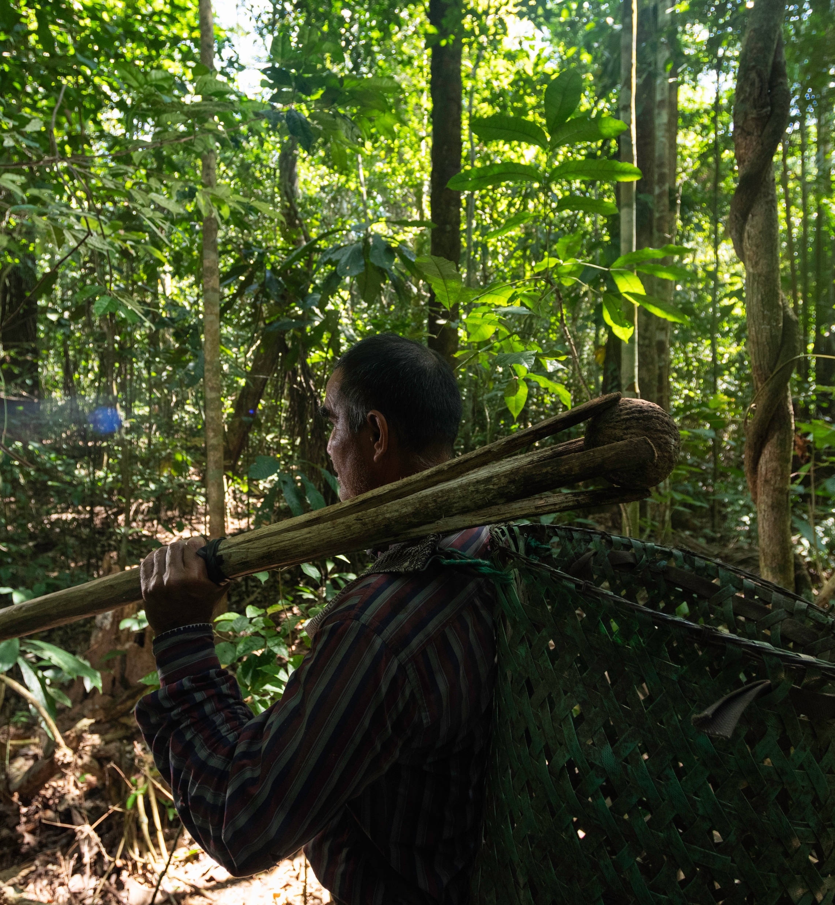
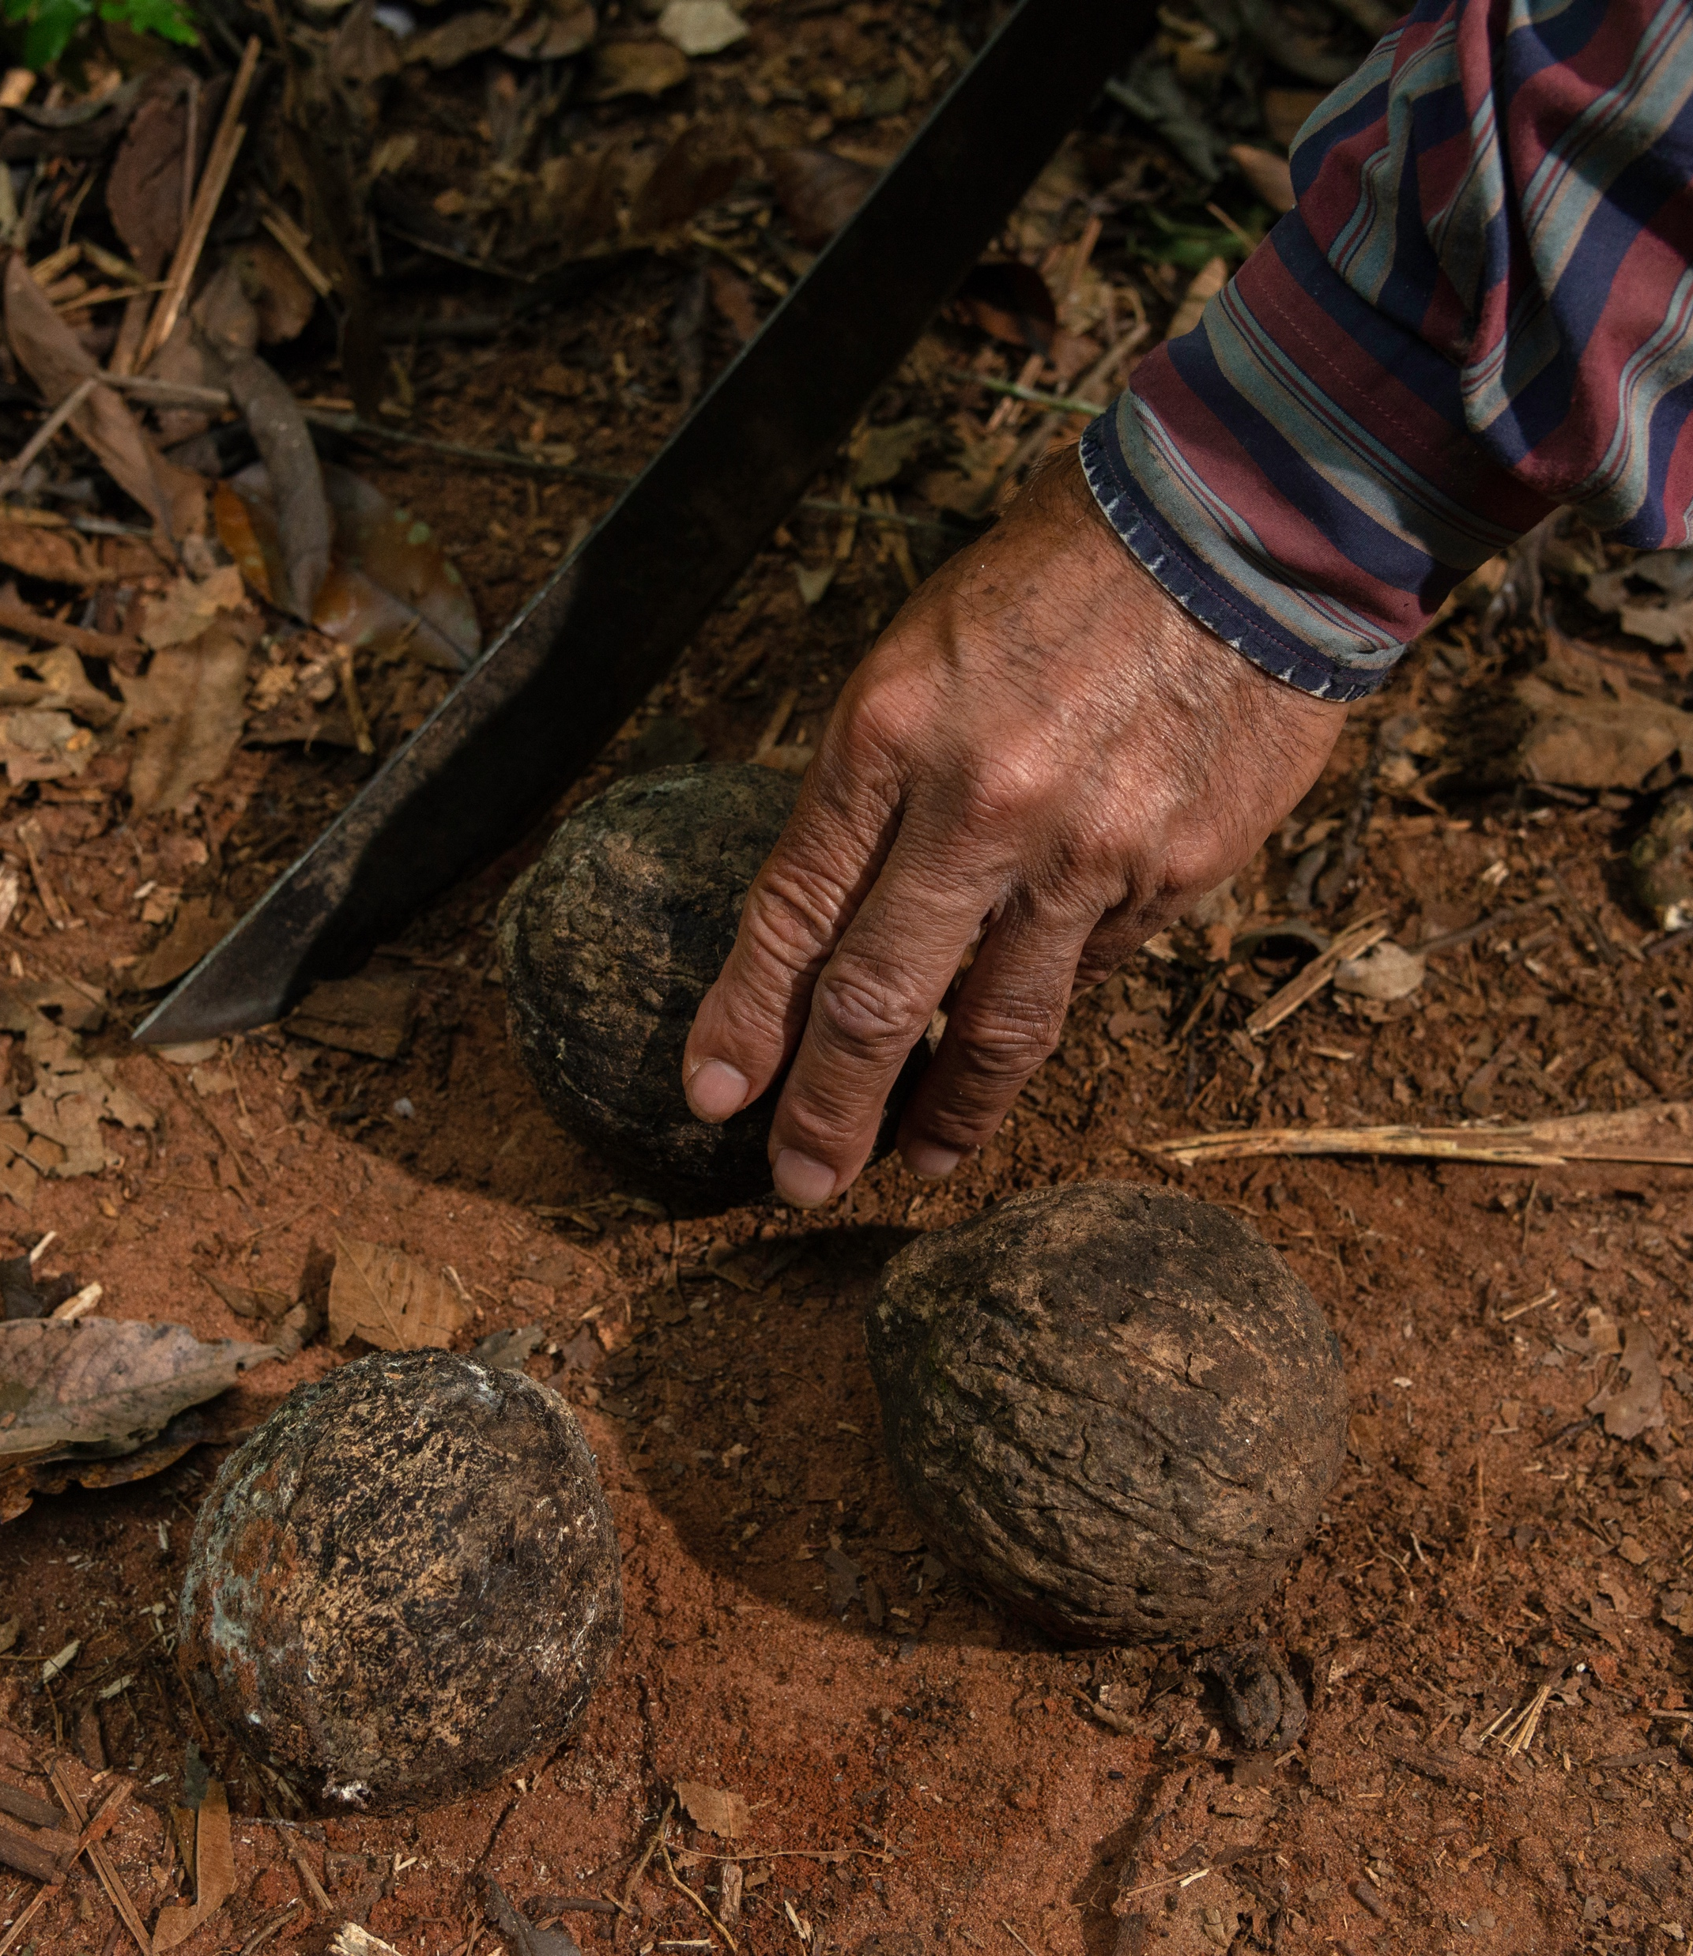
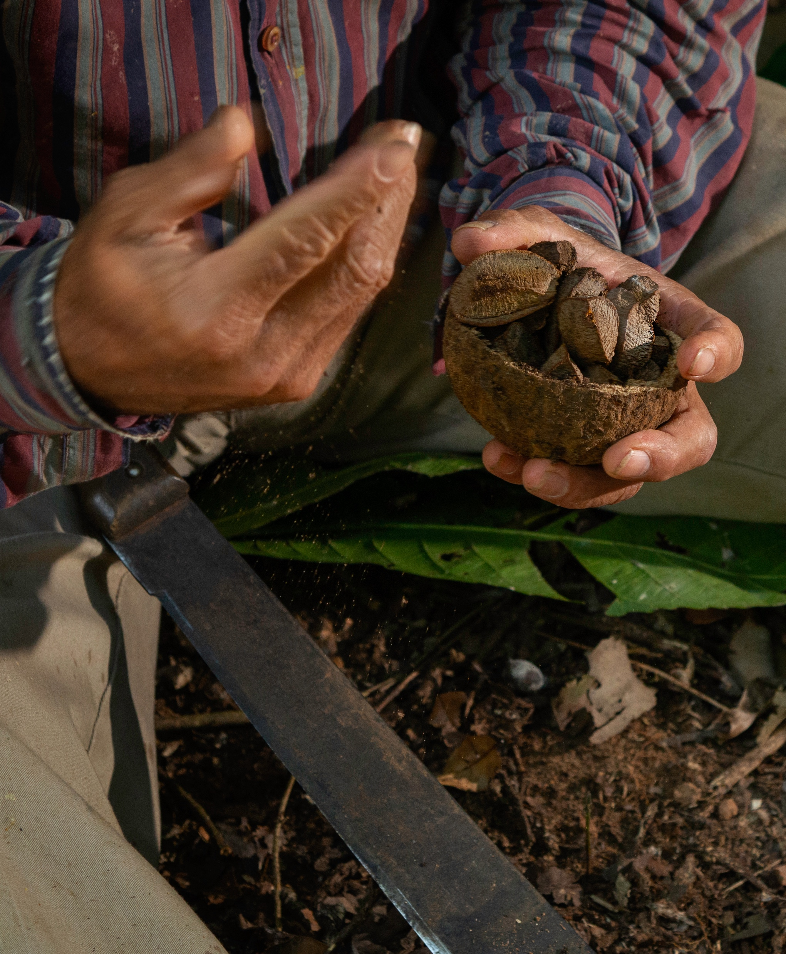
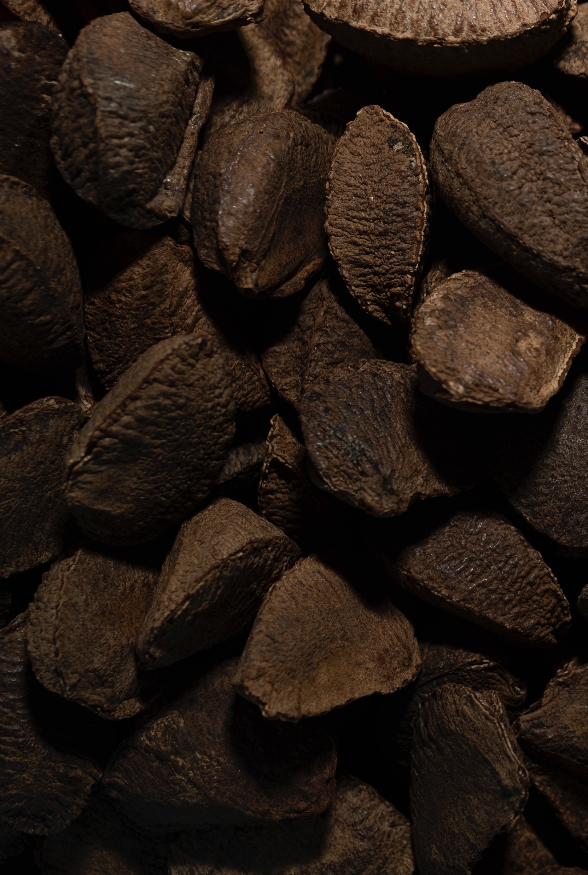
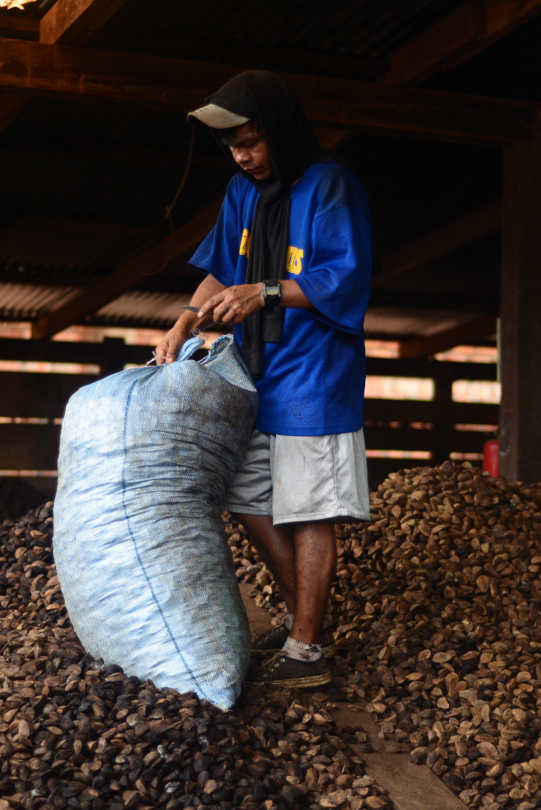
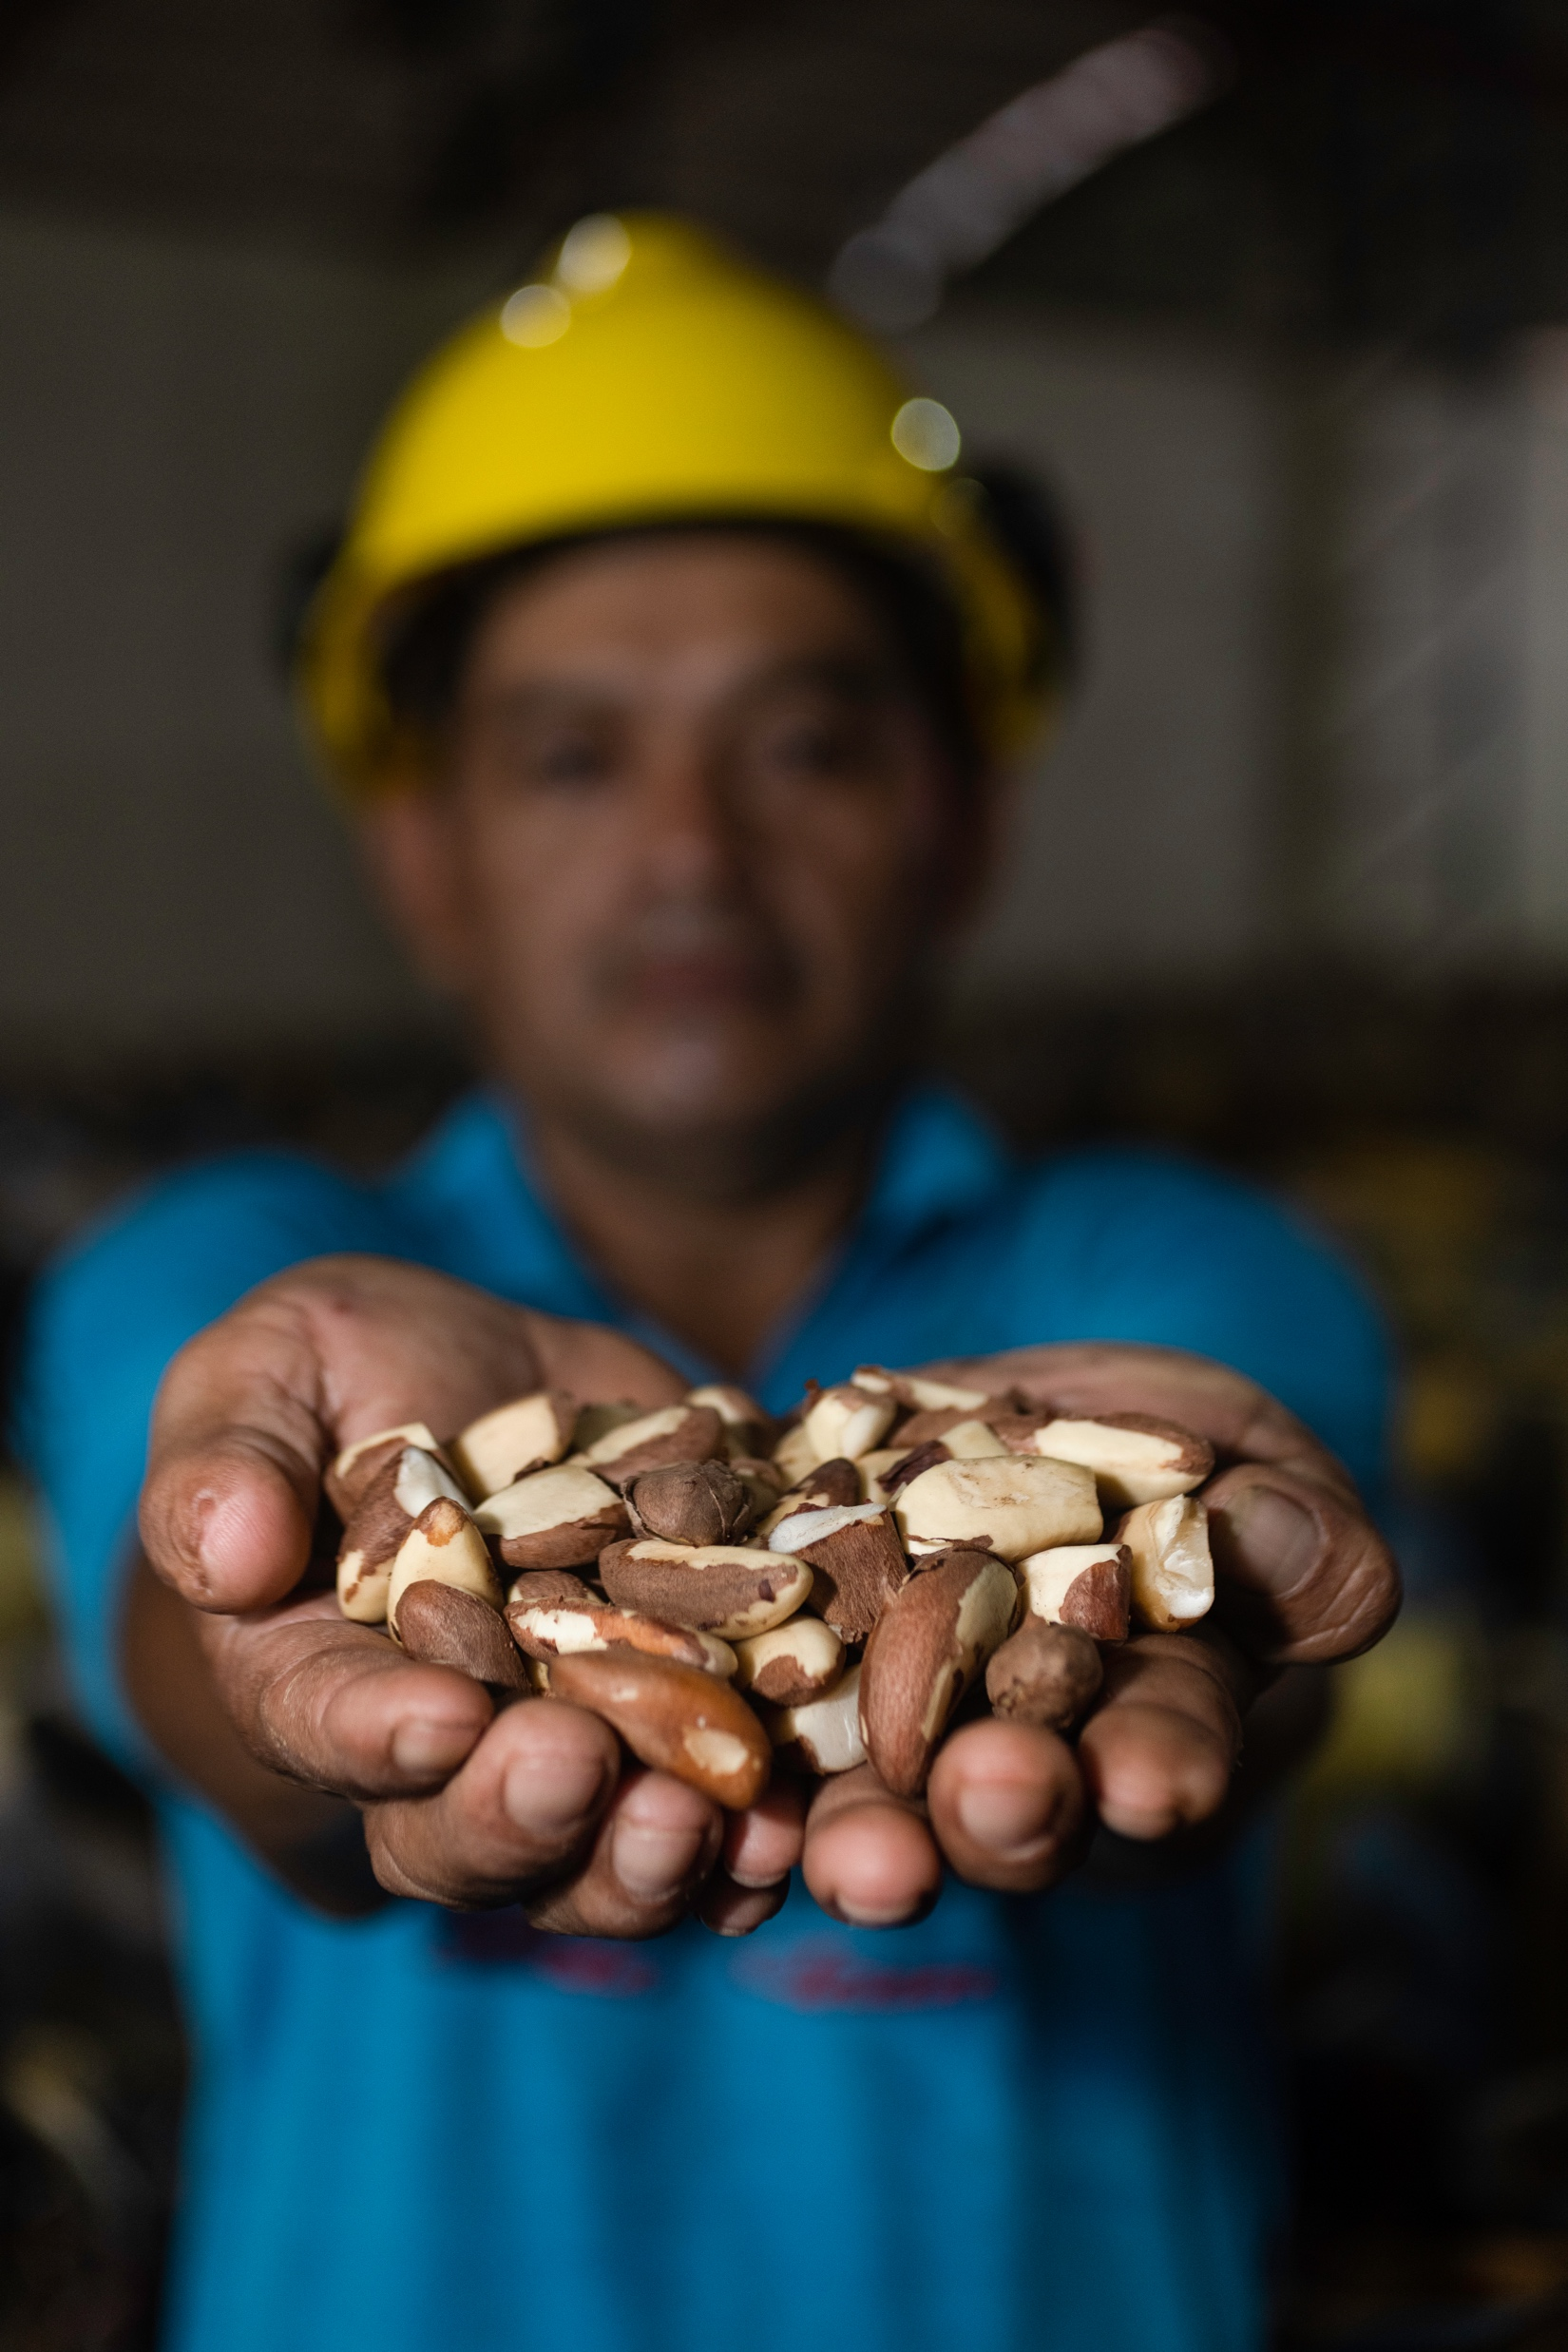
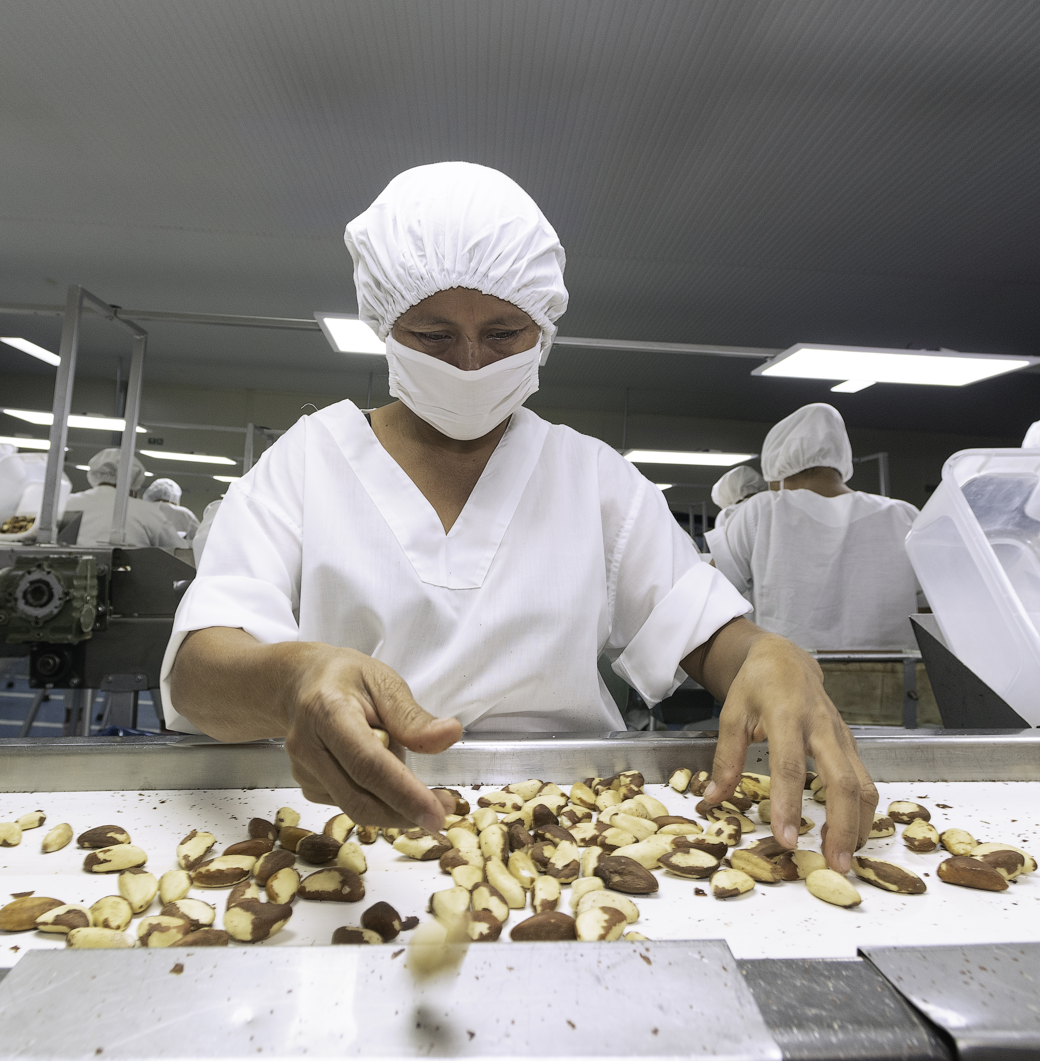
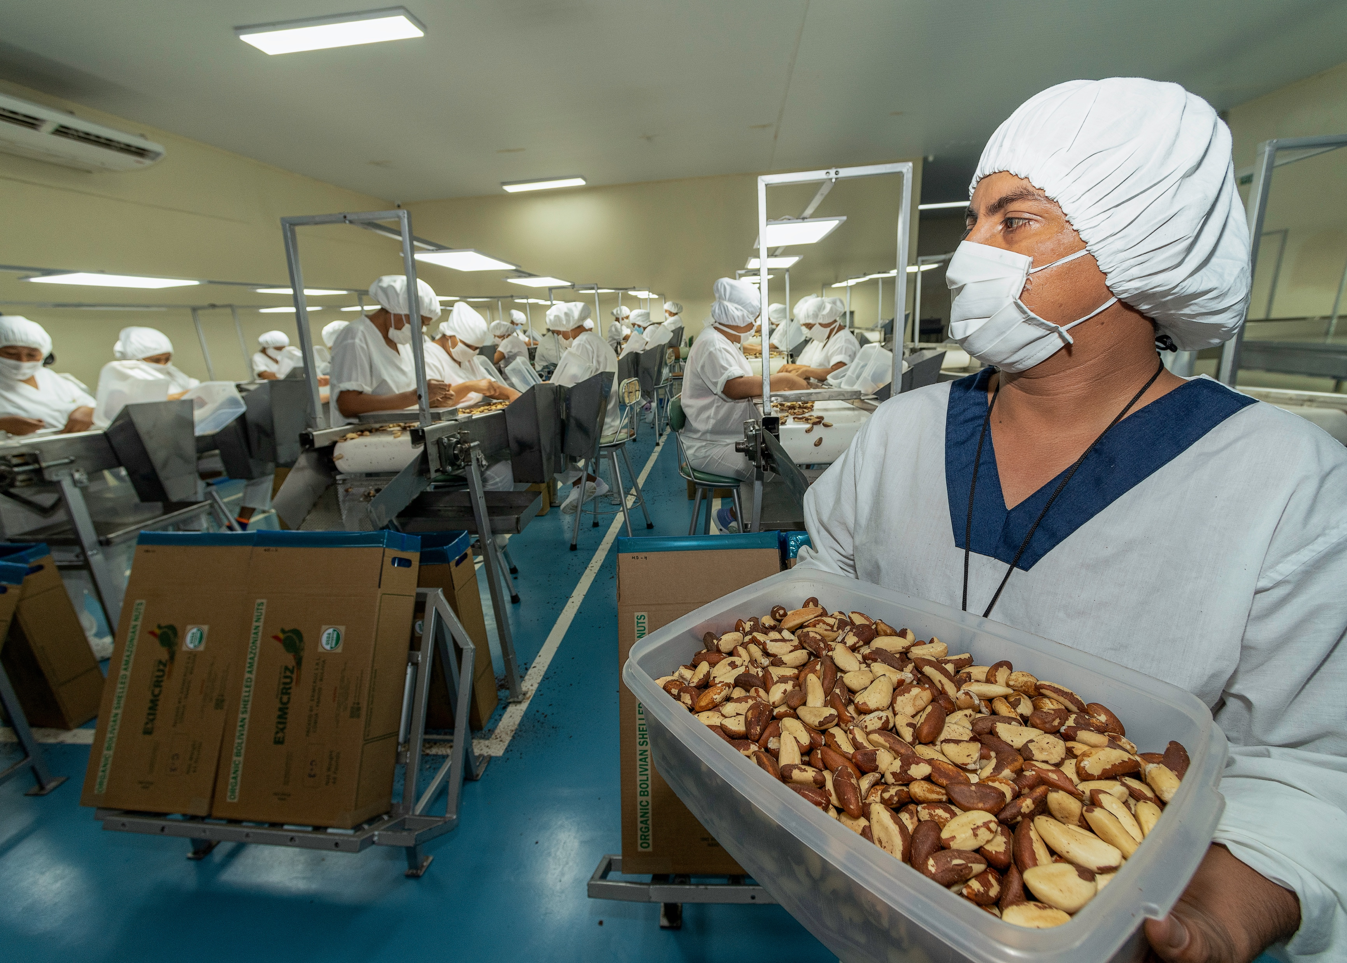
Brazil Nut
Photos: Conservación Amazónica- ACEAA

Slide 7
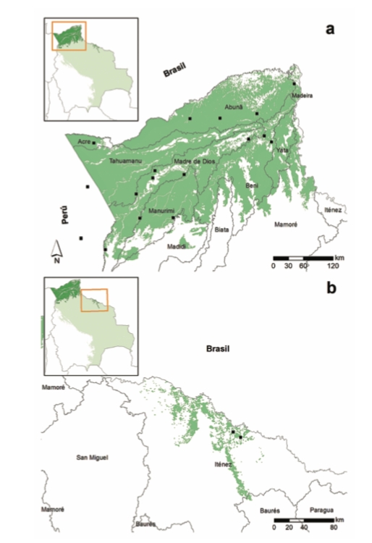
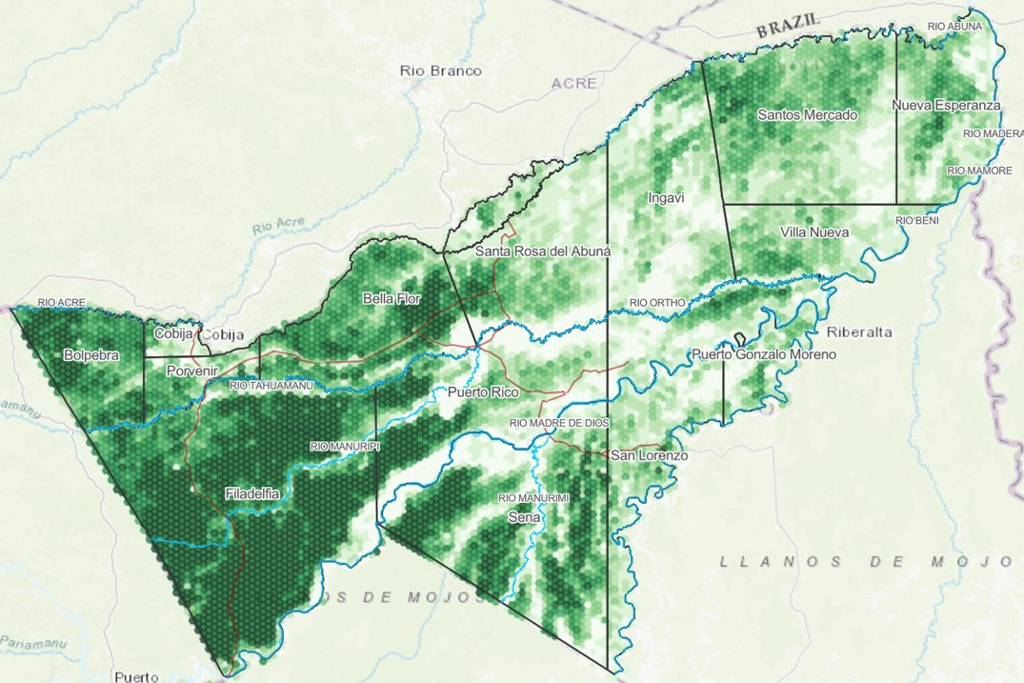
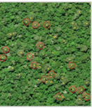
Brazil Nut
(Bertholletia excelsa)
8,4 million ha
(7% Bolivia)
There are 20,5 million Brazil nut trees into the Bolivian Amazon
Source: Conservación Amazónica-ACEAA

Slide 8
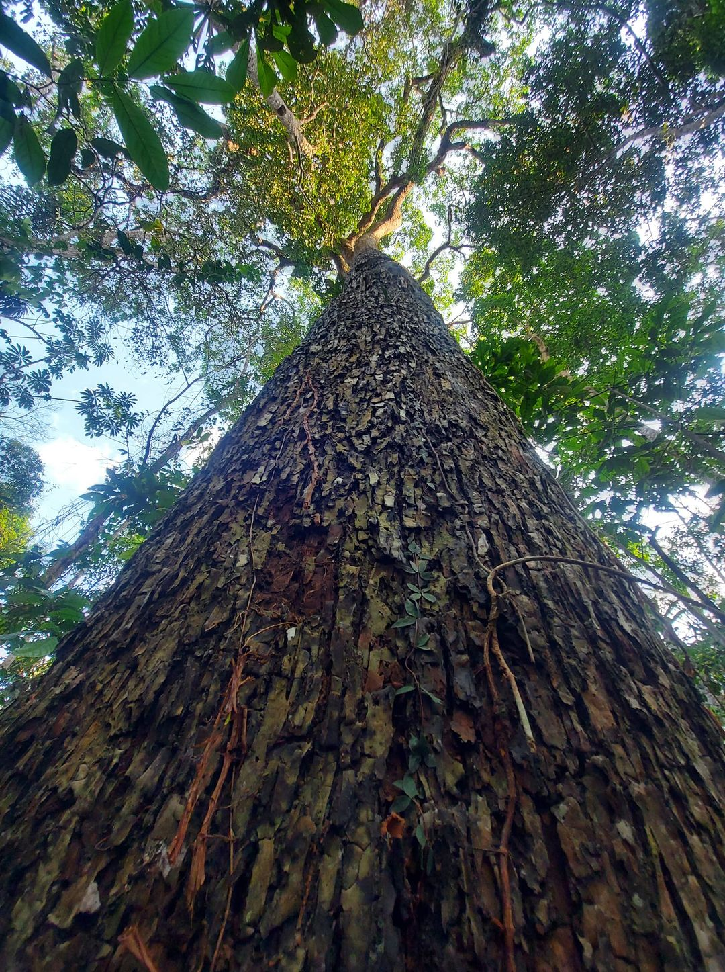
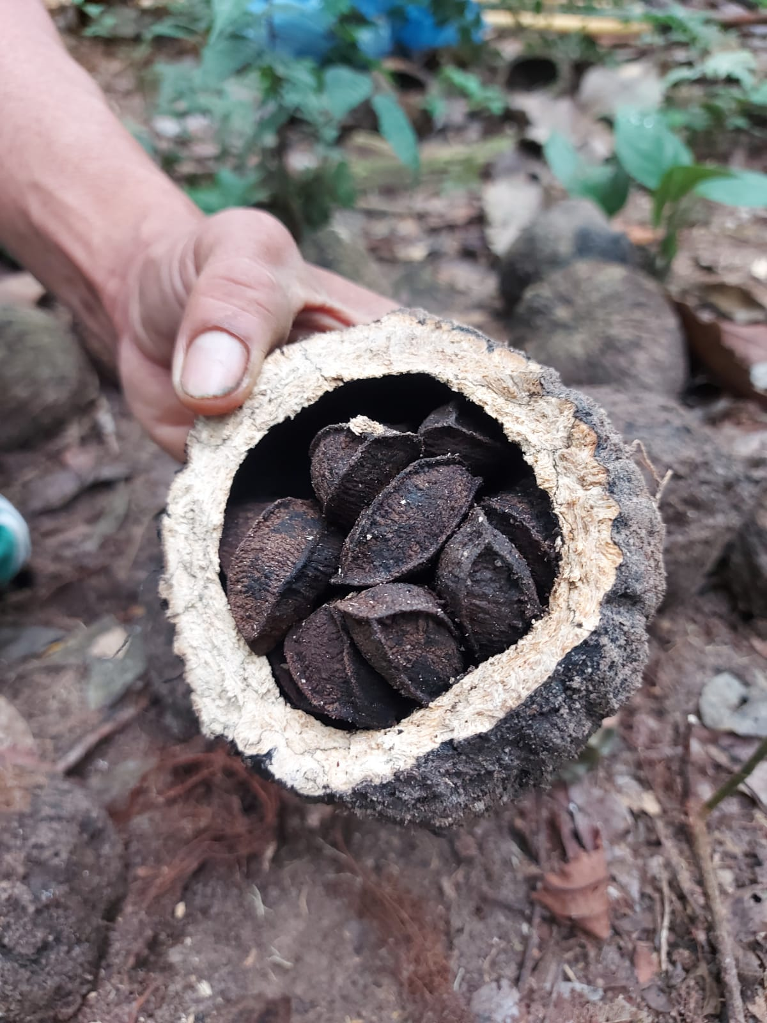
Local level:
+ 120,000 tons of Brazil nut in shell, anually.
+ 90,000 people works in the Brazil nut value chain.
For local communities, Brazil nut recollection means more than 50% of the anual income
National level
20-26 thousand tons of peeled Brazil nut is exported annually.
Bolivia exports near 75% of the global demand
Brazil nut is the first non traditional export item for Bolivia ($180 million average)

Slide 9
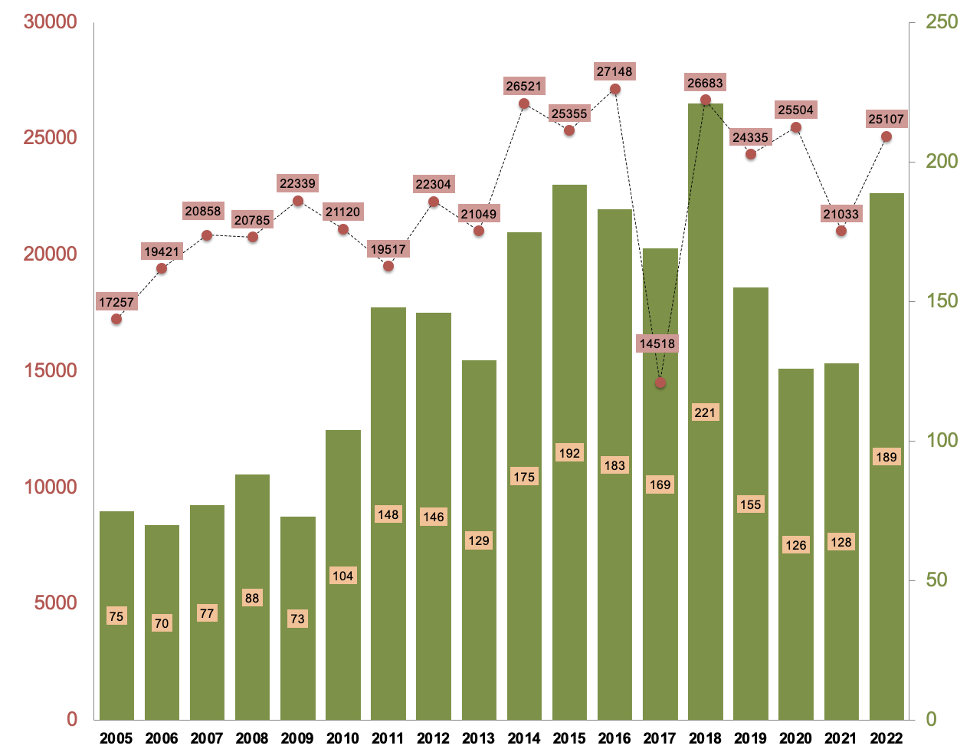
Bolivian's Brazil nut exportation (2005-2022)
Brazil nut Tons (t)
Million dolars (MM)
Source: IBCE (https://ibce.org.bo)
Year

Slide 10
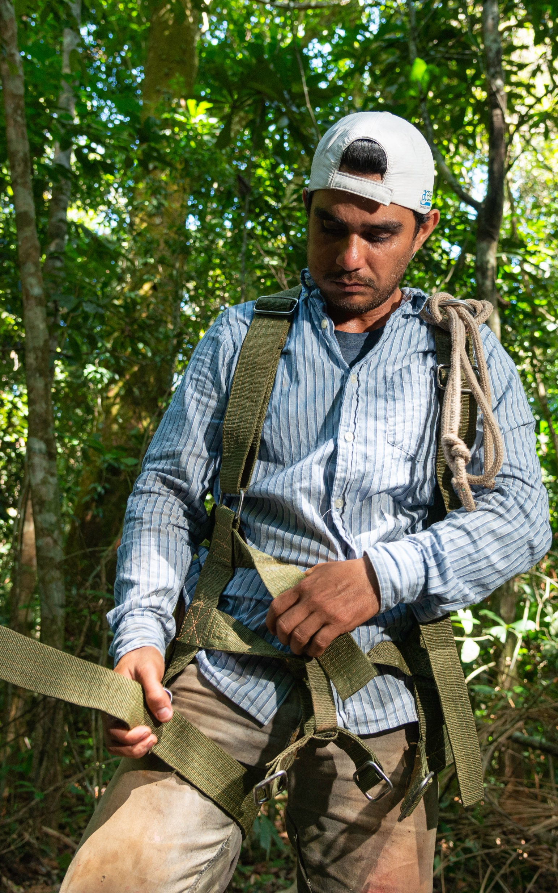
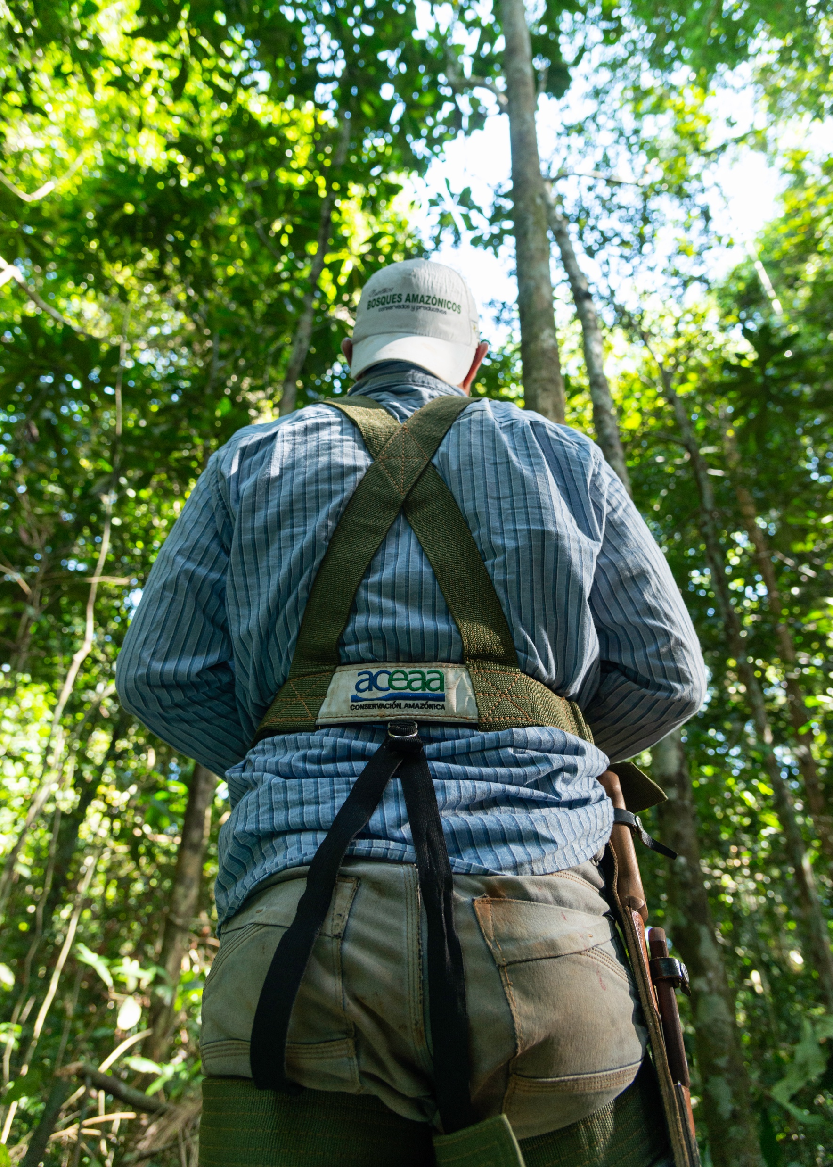
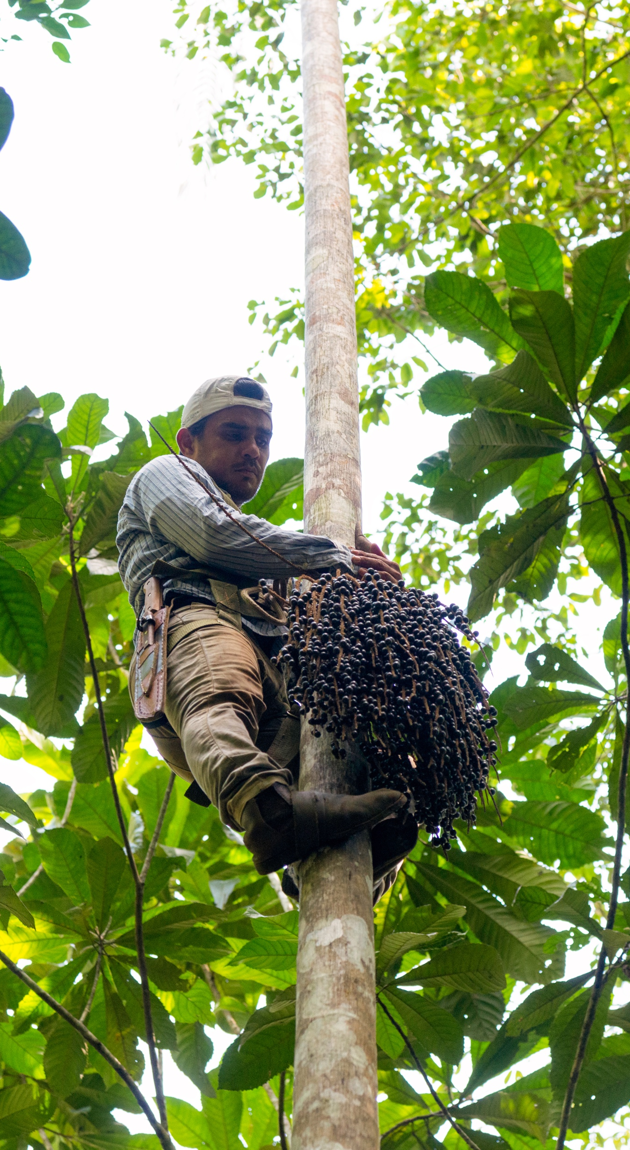
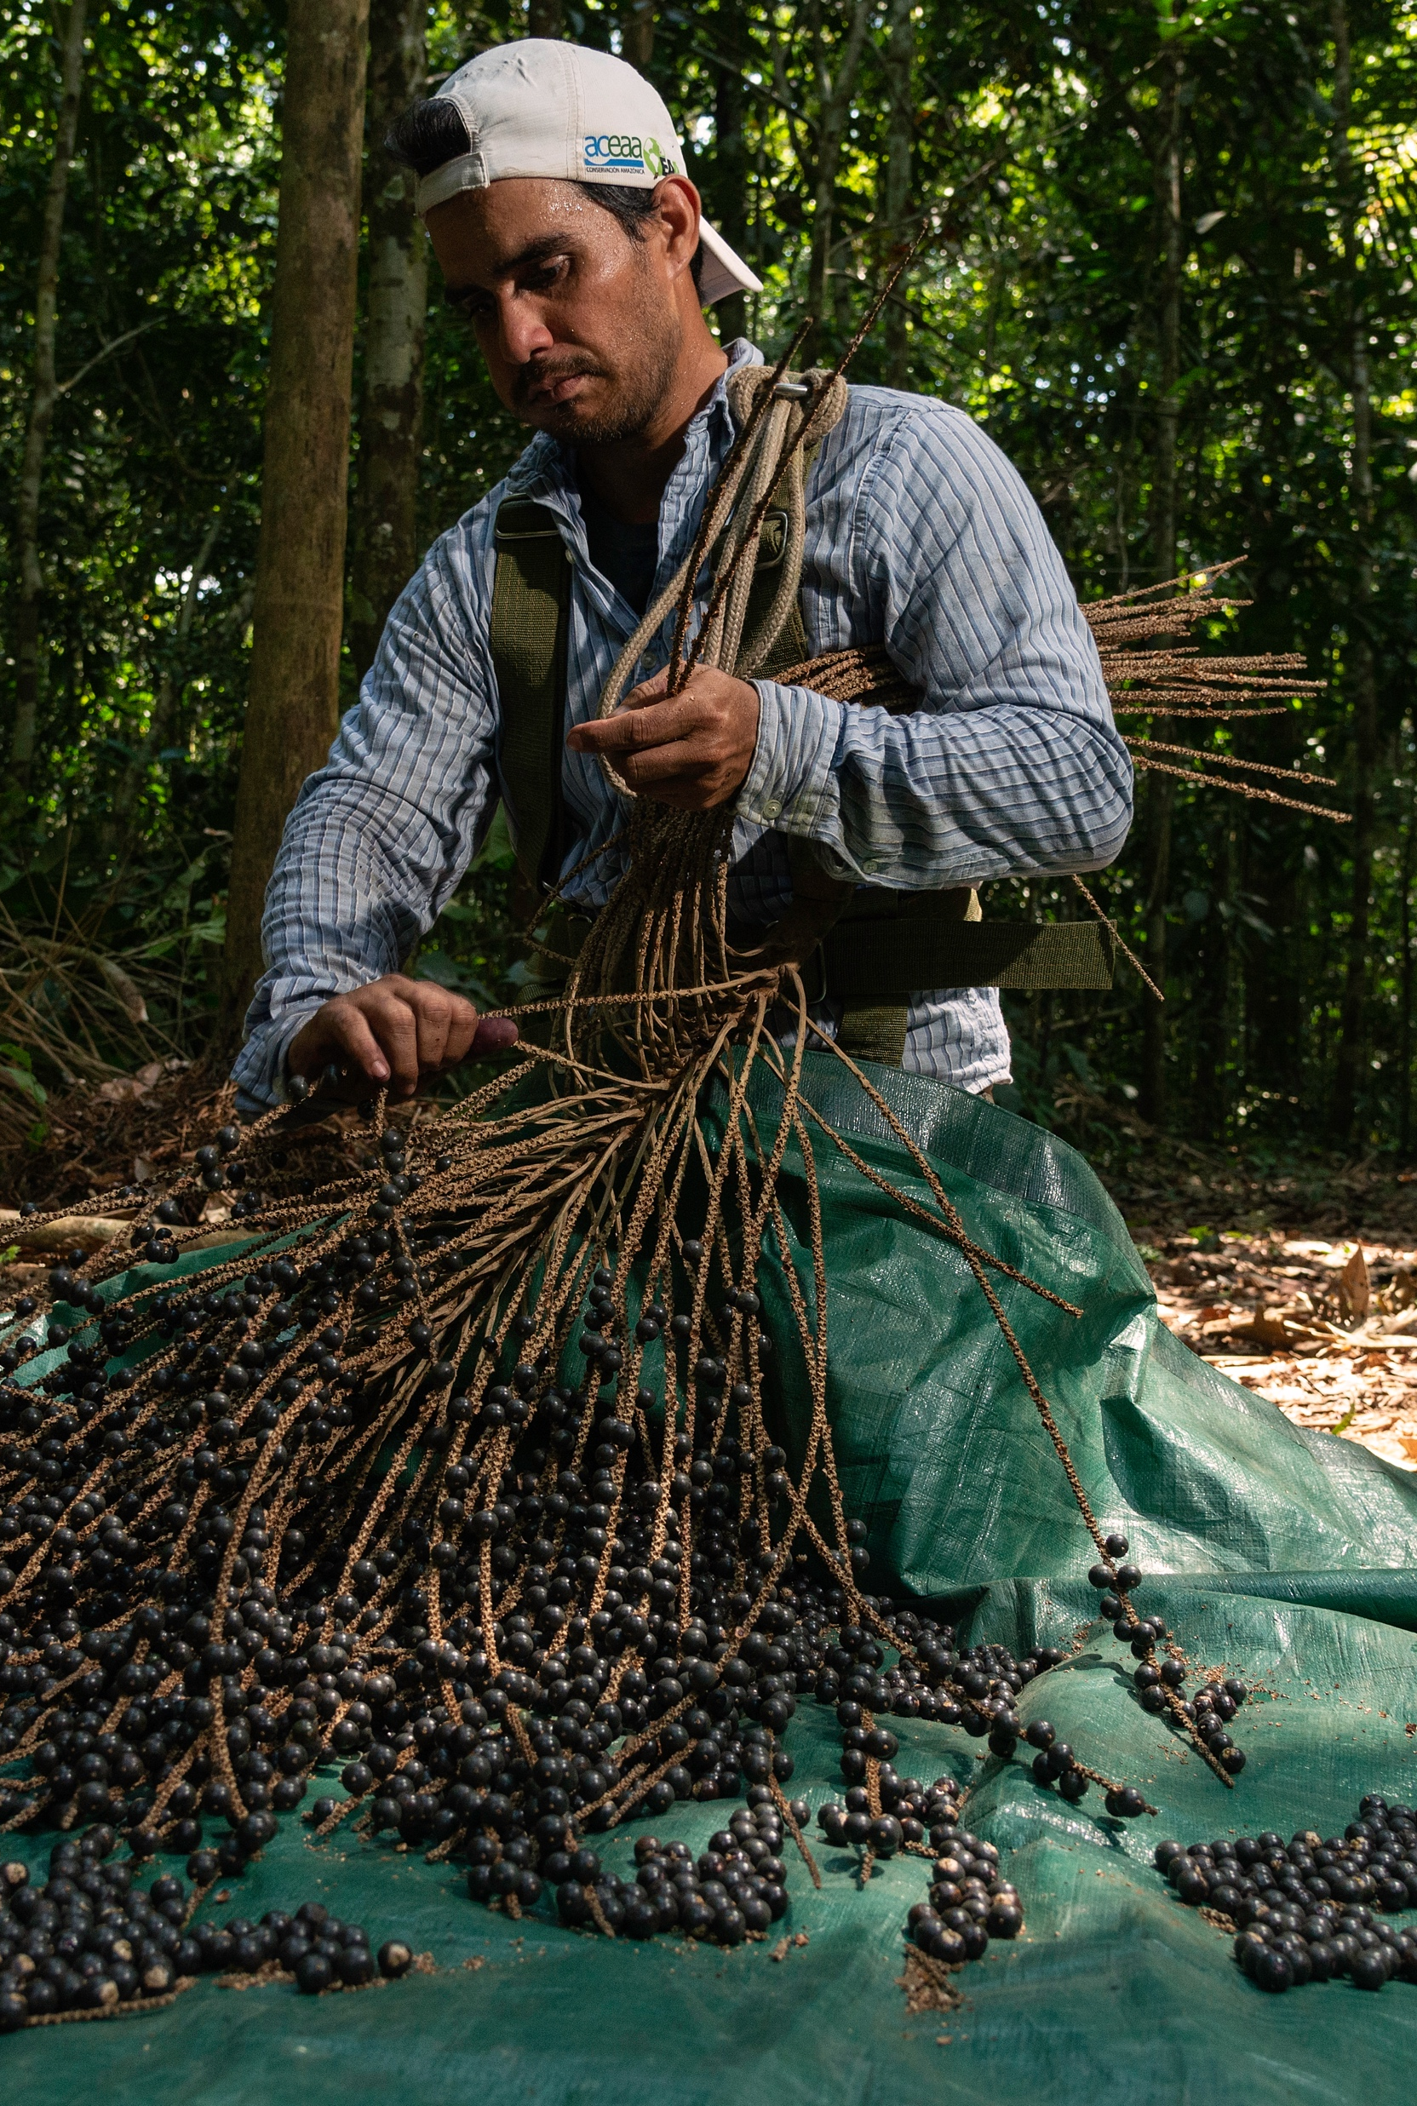
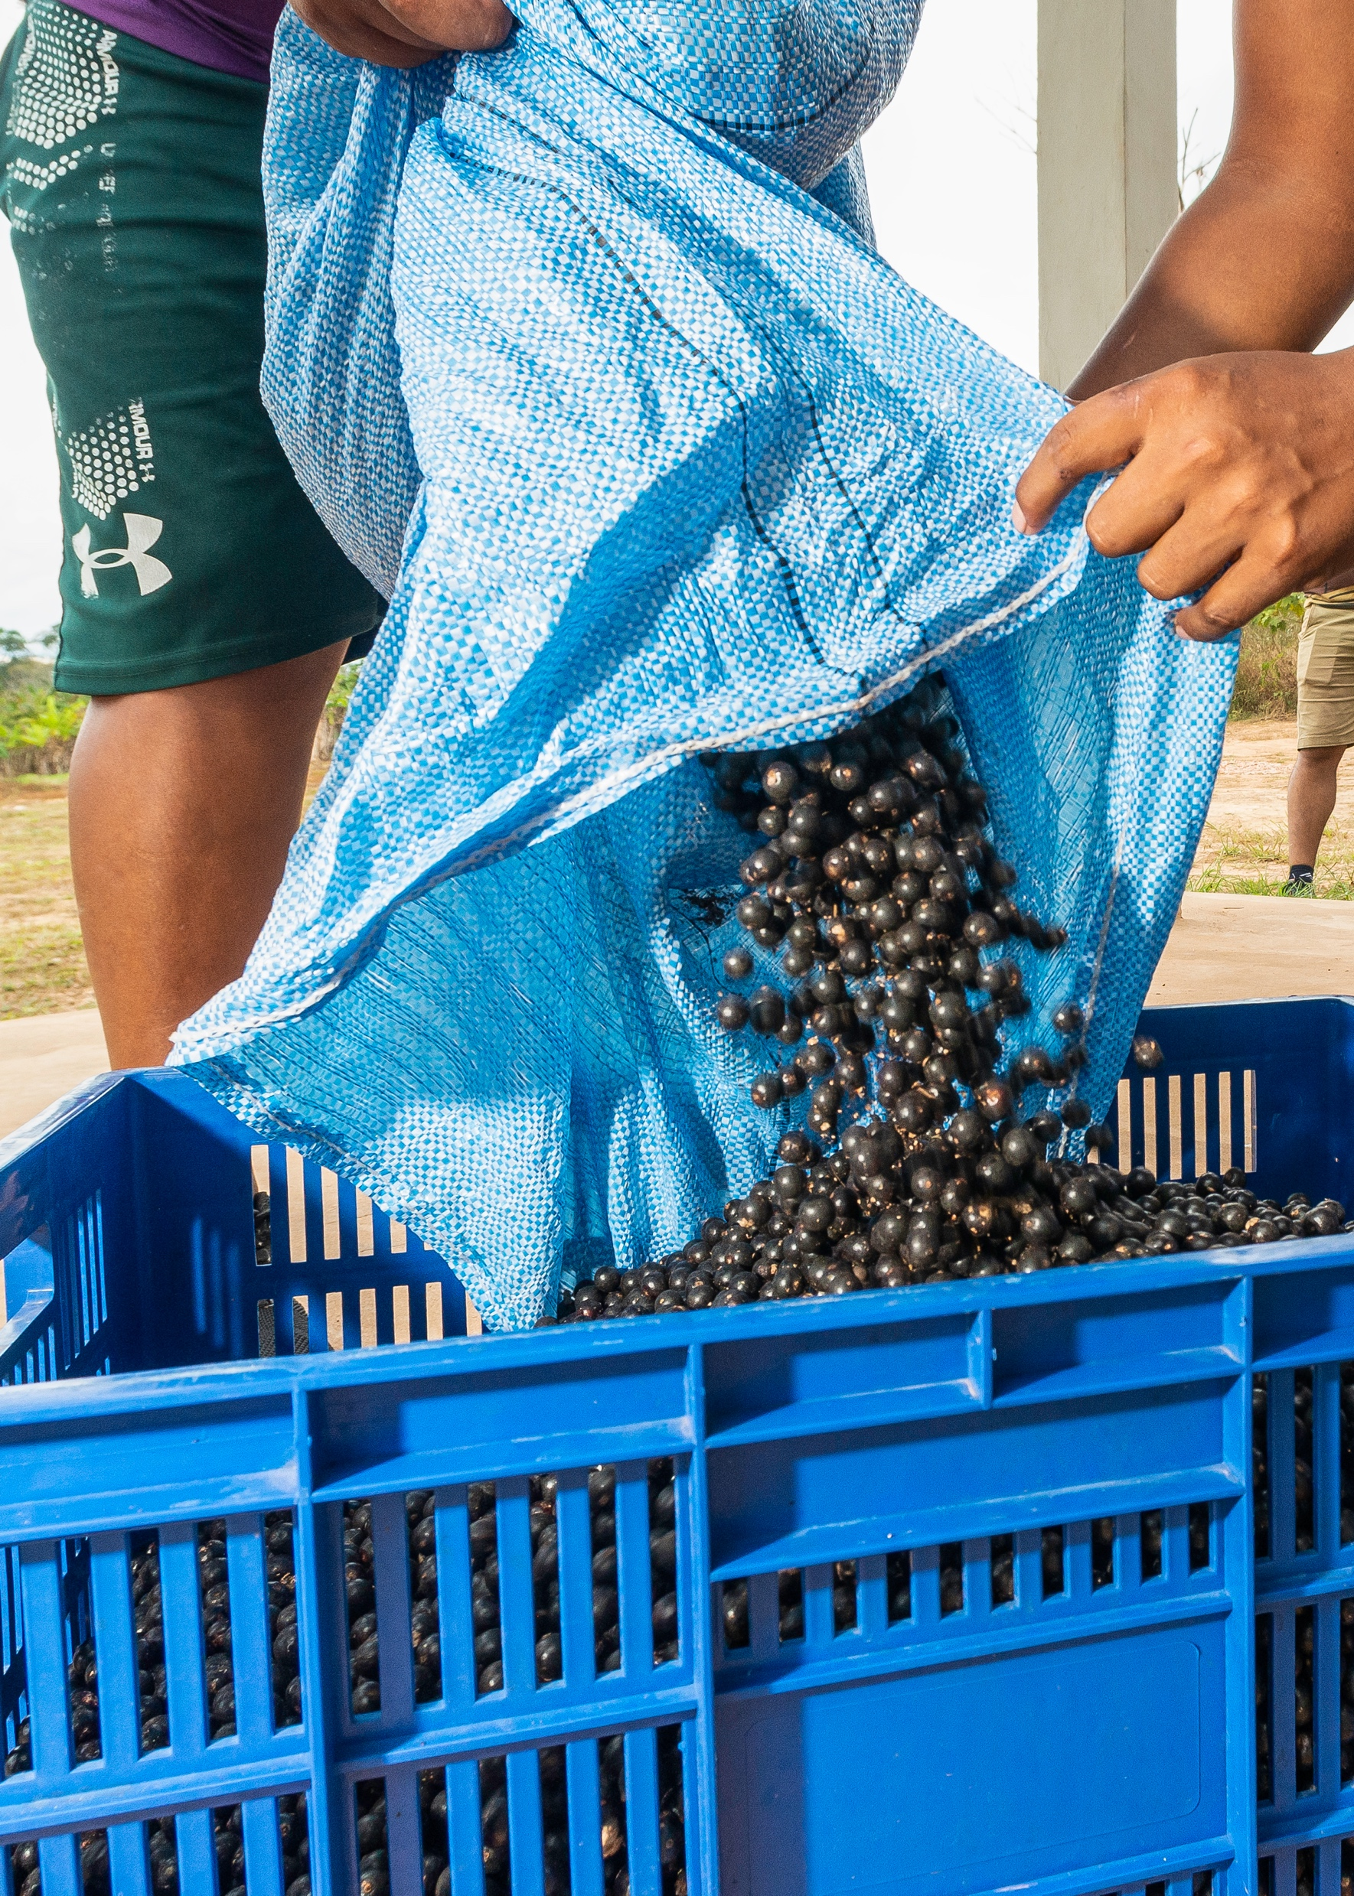
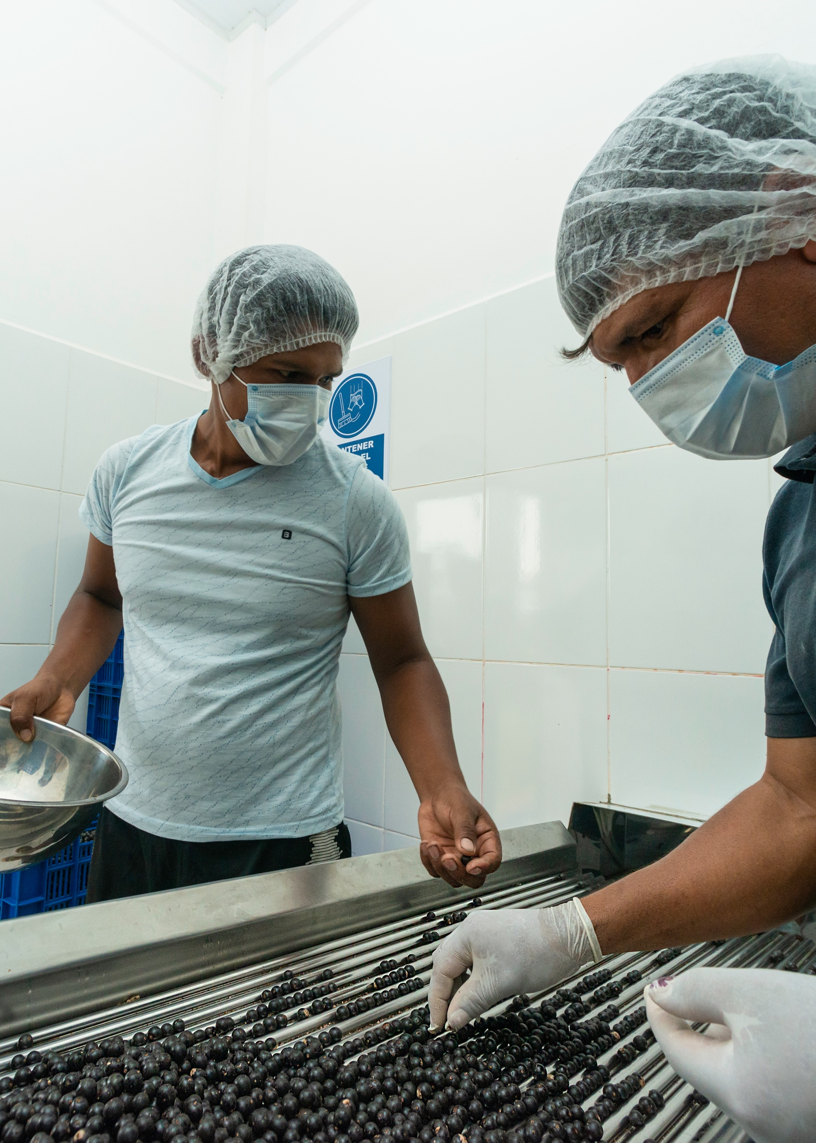
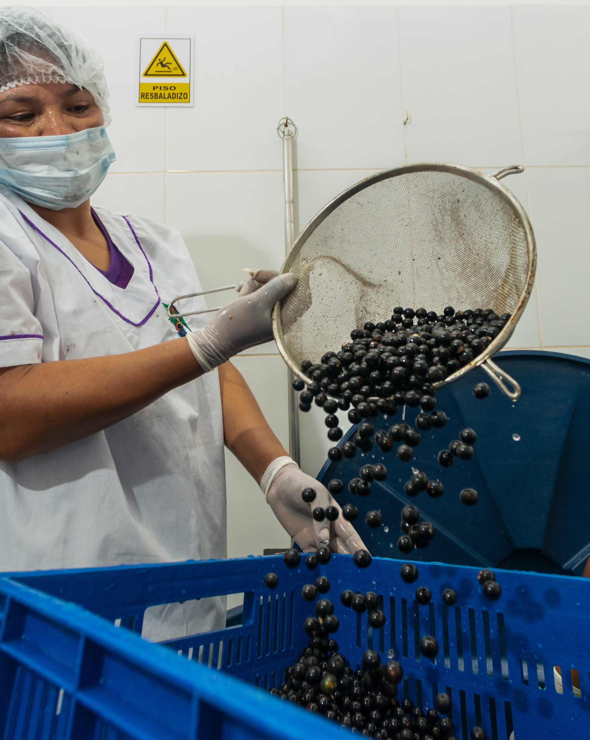
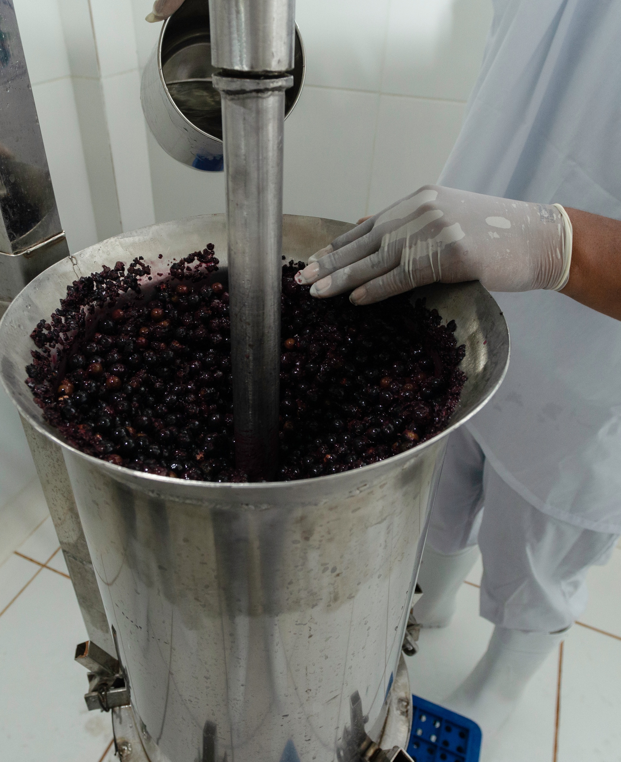
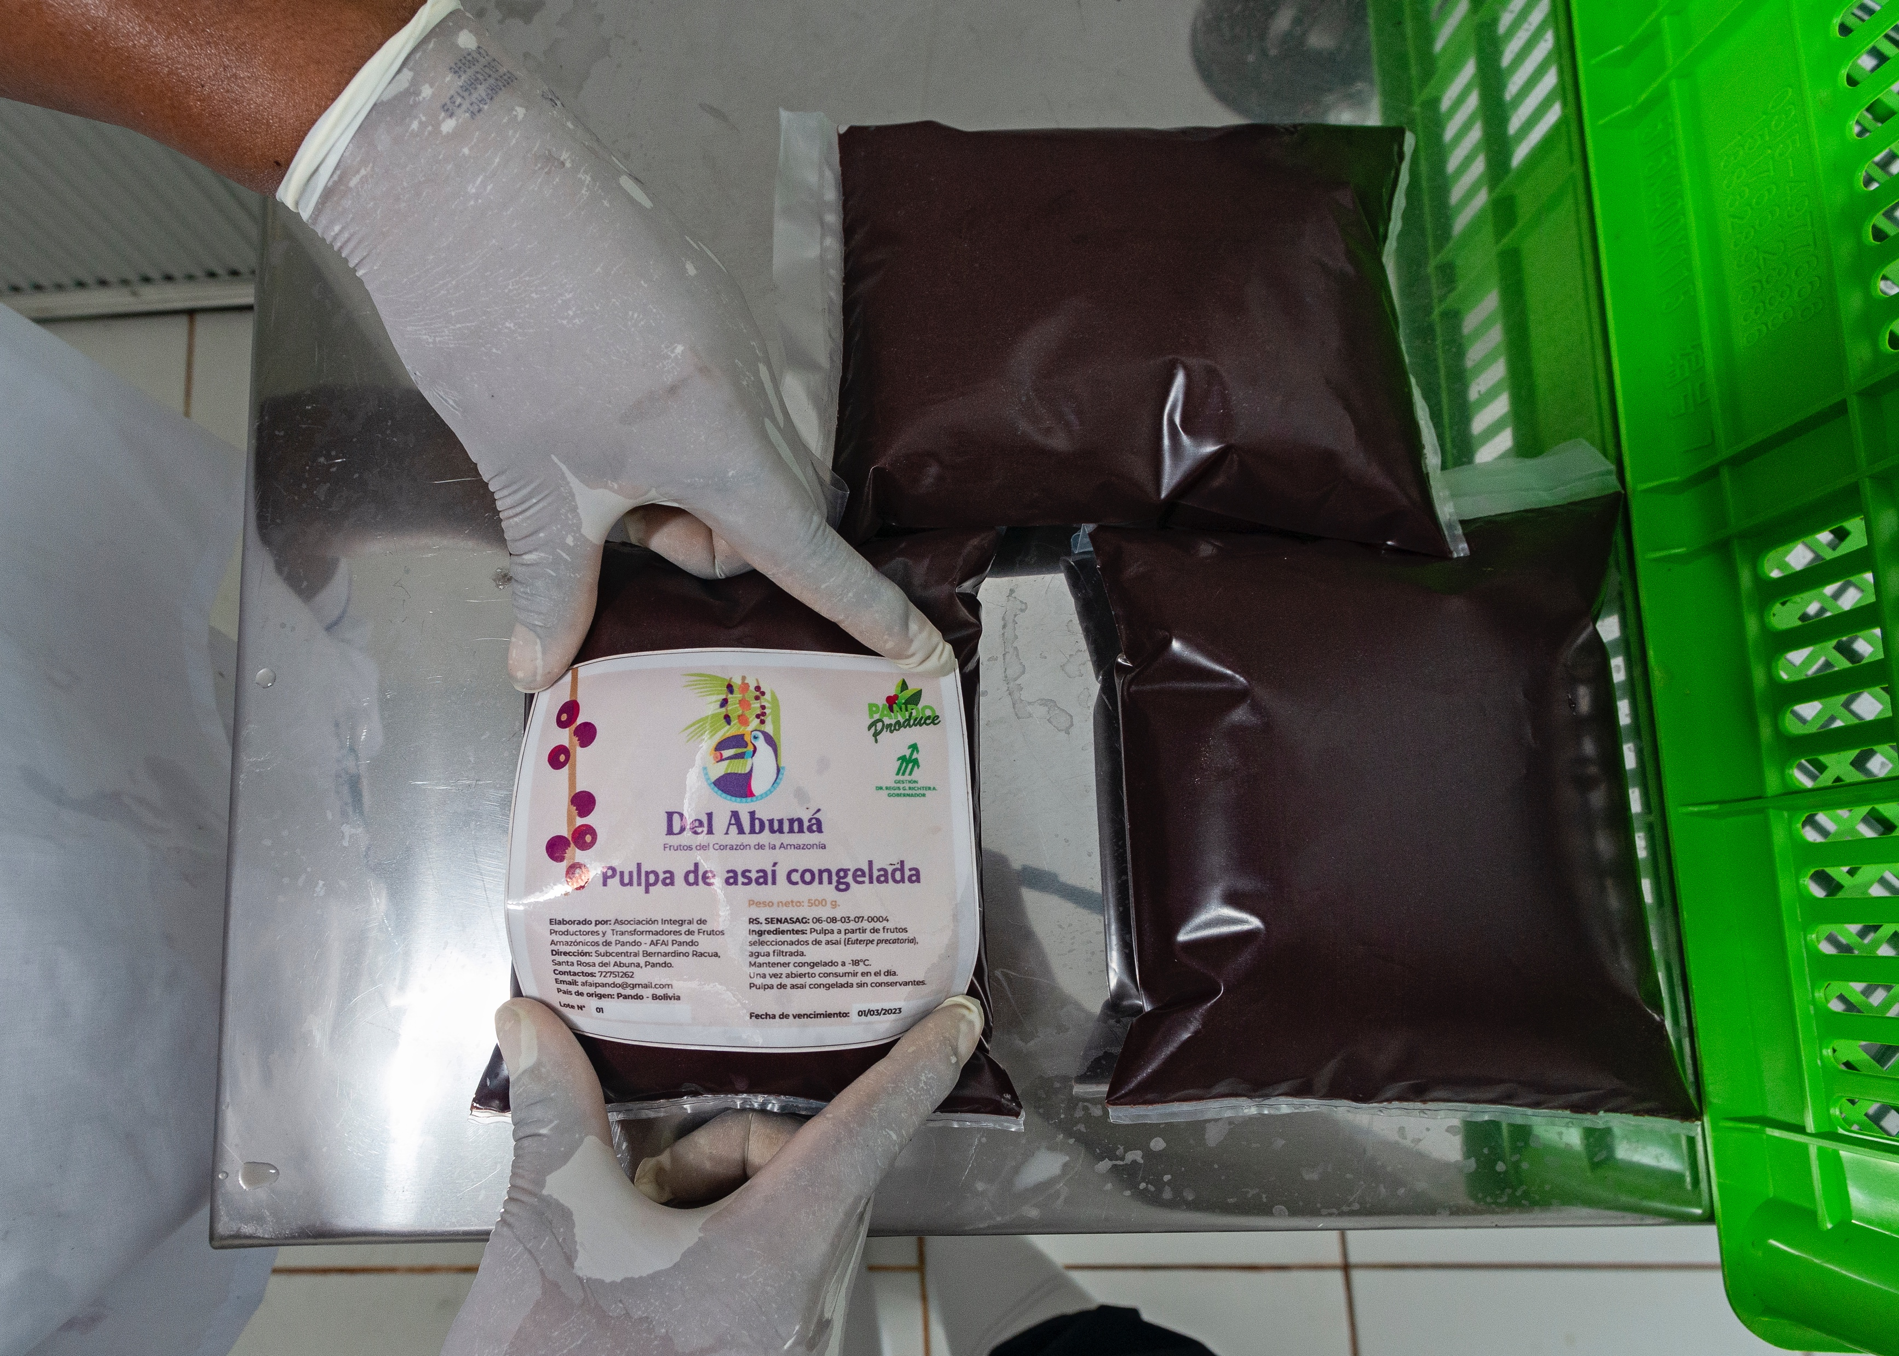
Asaí
Photos: Conservación Amazónica- ACEAA

Slide 11
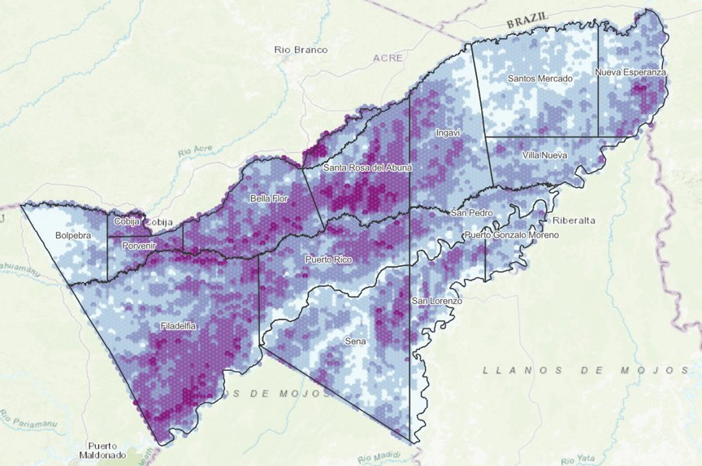
Asaí
(Euterpe precatoria)
4 million Ha covered by asai palms
268 million of asai palm trees
186 million of asai productive palm trees
2 - 4 million tons of asai berries
Source: Conservación Amazónica-ACEAA

Slide 12
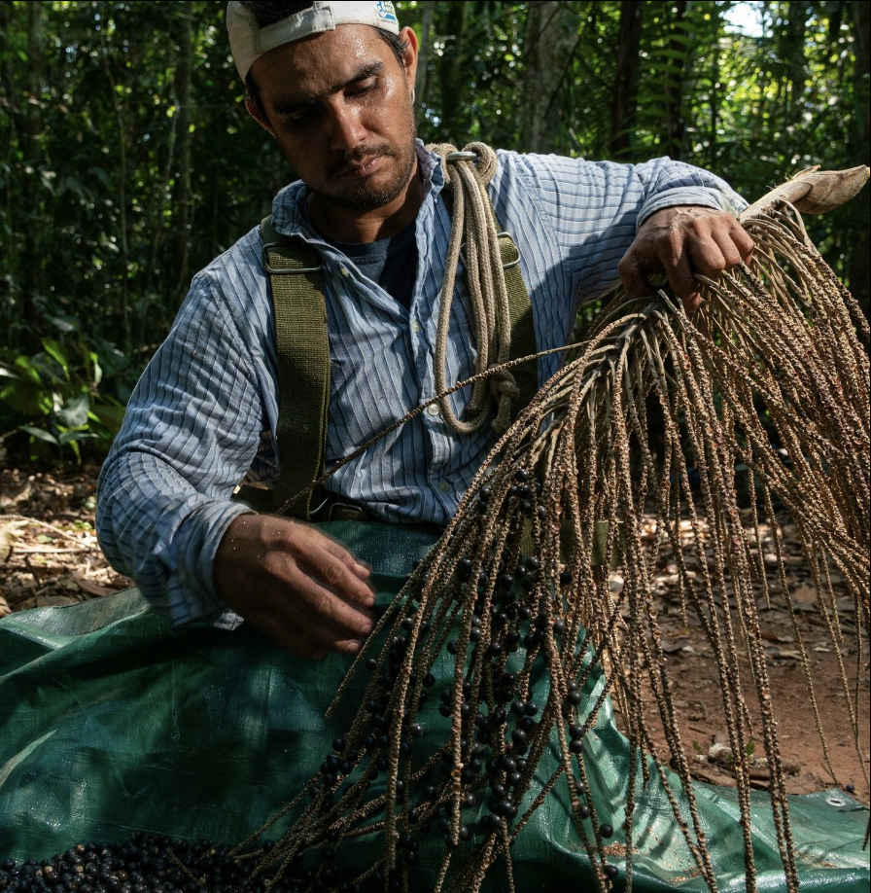
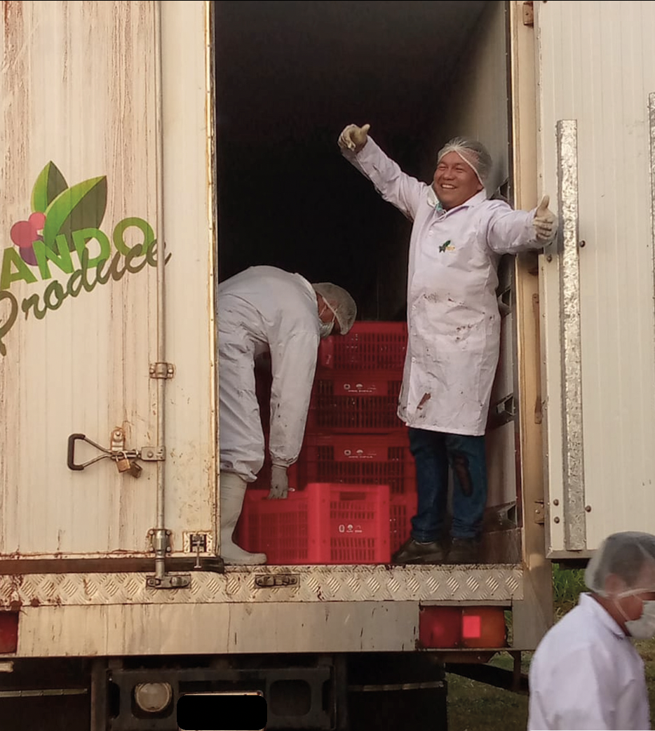
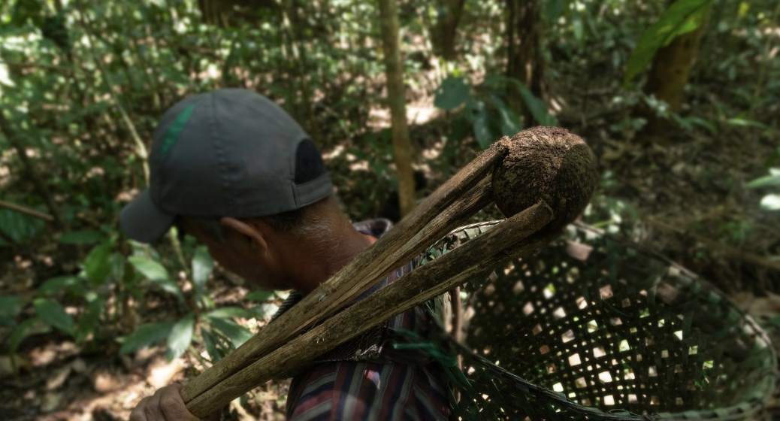
Bottlenecks for forest management:
The backbone of local economy is the Brazil nut value chain, but work and transparency are still needed into value chain.
Asai is another forest product with a huge potential but, as a wild species with a broad distribution in Pando, the consolidation of a frost chain is needed, one that includes innovative techonology to reduce the production costs.
The asai value chain, as a new alternative, needs a finance mechanisms to consolidate the market access

Slide 13
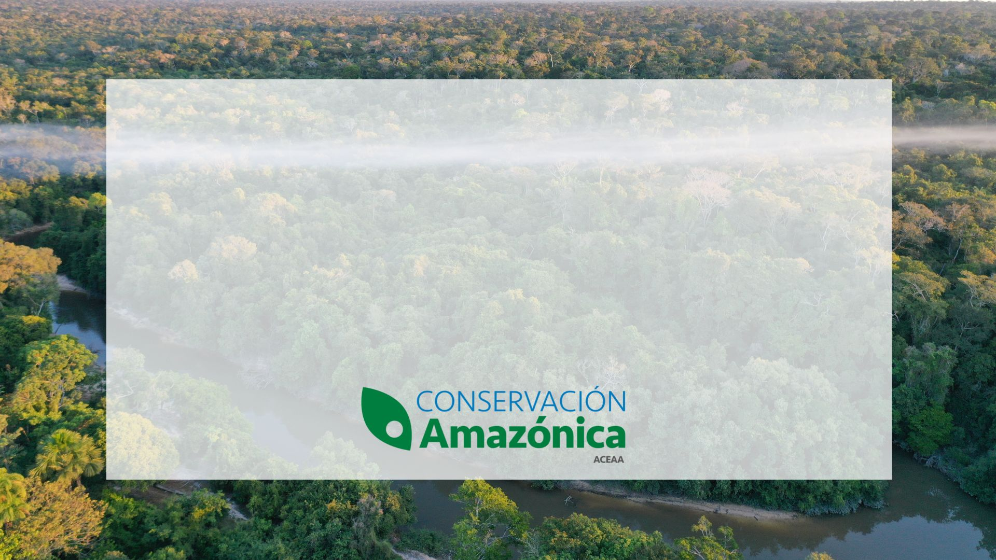



A productive Forest, is a heathy Forest.
A healthy forest, is resilient to climate change impacts.
www.conservacionamazonica.org.bo
www.frutosamazonicos.org.bo

